Slide 1
VirusGenerator
Password:
VGAQuarius090317

Slide 2
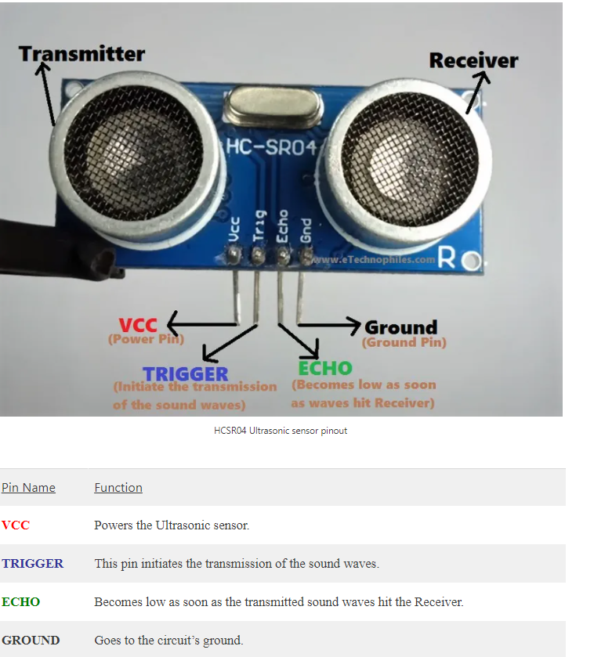
ULTRASONIC SENSOR HCSR04

Slide 3
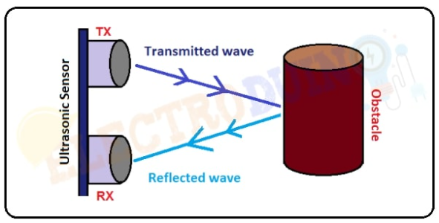
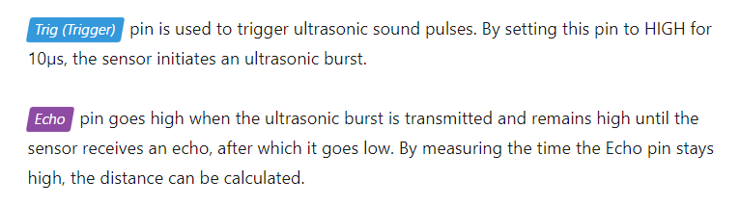
Distance to Obstacle = (Transmitted wave + Reflected wave) / 2

Slide 4
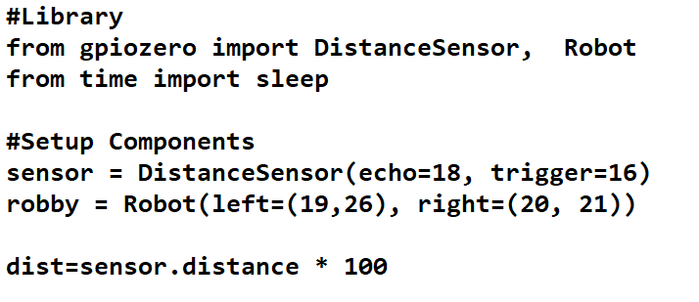
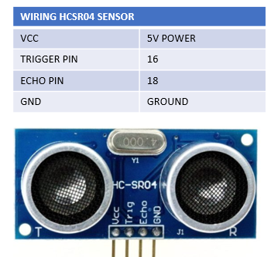
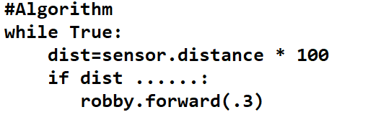

Slide 5
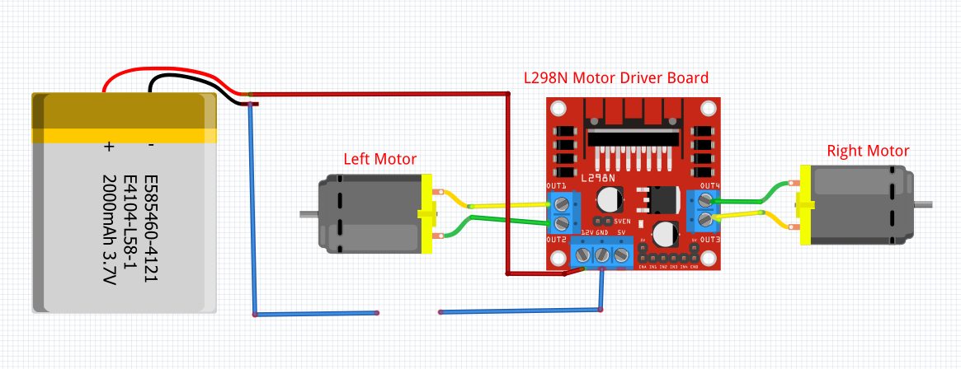
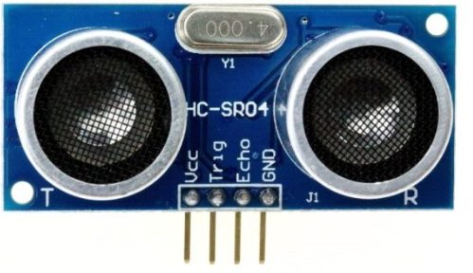
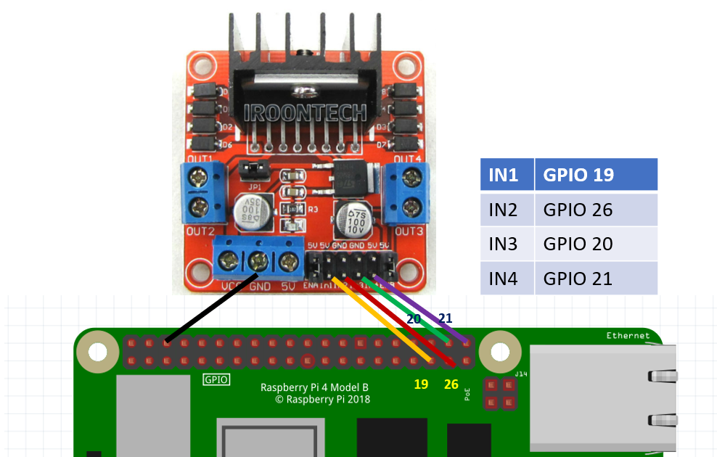
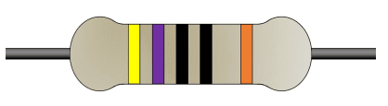
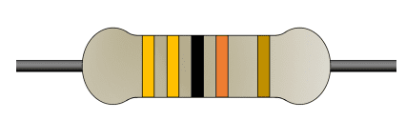
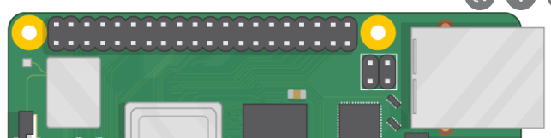
Wiring Diagram for Robot and Ultrasonic Sensor
WIRING HCSR04 SENSOR
VCC | 5V POWER
TRIGGER PIN | 16
ECHO PIN | 18
GND | GROUND
18
330 ohm
VCC
GND
16
470 ohm

Slide 6
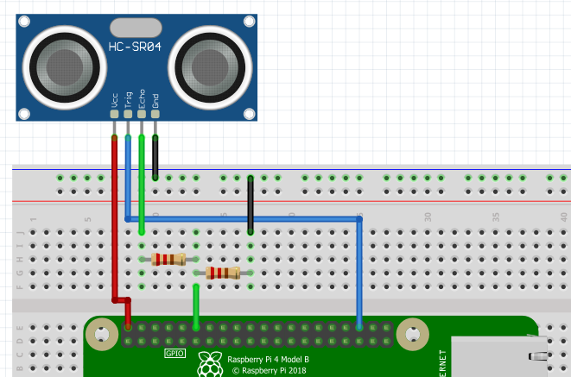
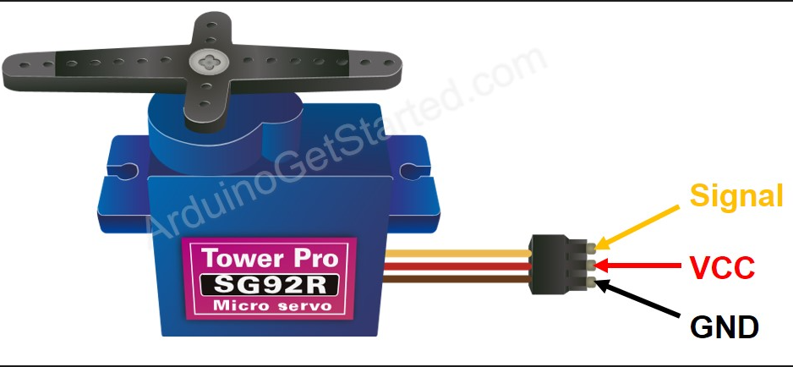
Wiring Diagram for Ultrasonic Sensor and Servo Motor
Voltage Divider
To convert 5v to 3v
330 ohm
470 ohm
5V
GND
GPIO 17
Pin 18
Pin 16
5V
https://gpiozero.readthedocs.io/en/stable/api_input.html?highlight=distancesensor#gpiozero.DistanceSensor
https://gpiozero.readthedocs.io/en/stable/api_input.html?highlight=distancesensor%5C#distancesensor-hc-sr04

Slide 7
SERVO MOTOR
GPIO 17
5V

Slide 8
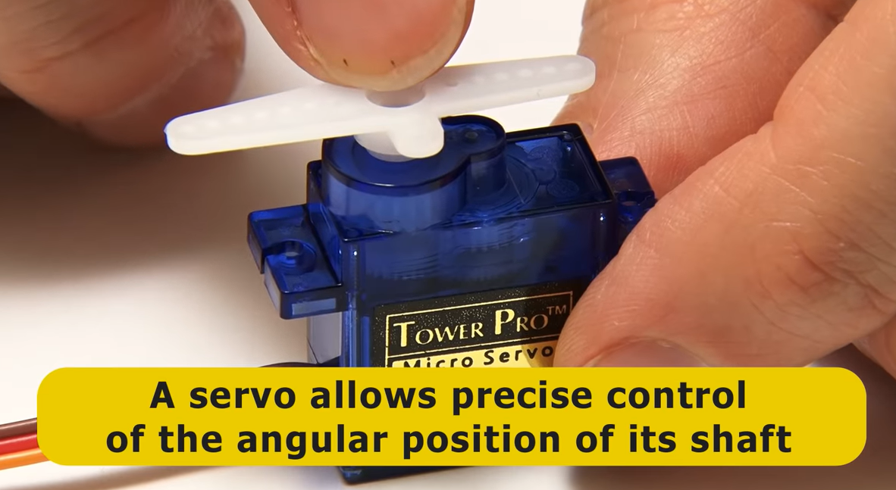

Slide 9
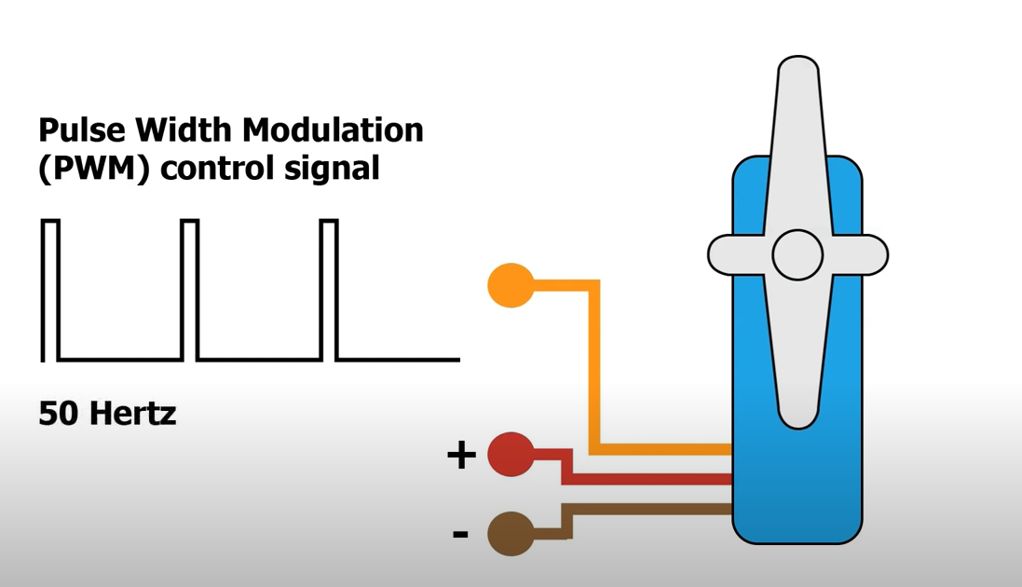
50 Cycle Per Second
1 +ve pulse -> 0.02 second

Slide 10
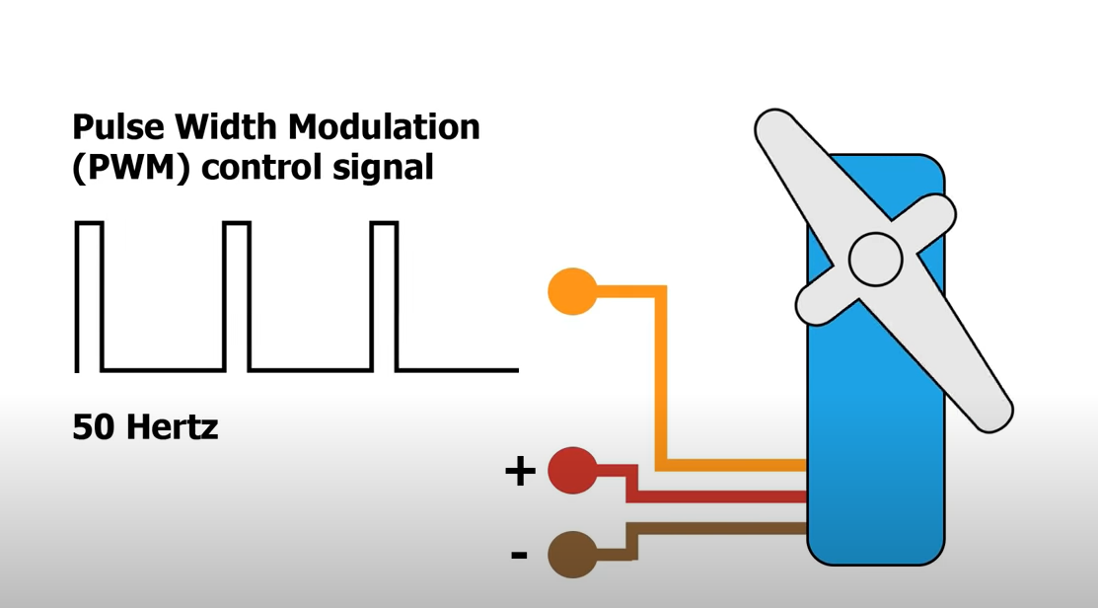
50 Cycle Per Second
1 +ve pulse -> 0.02 second
Angle ~ Length of +ve pulse (DUTY CYCLE)

Slide 11
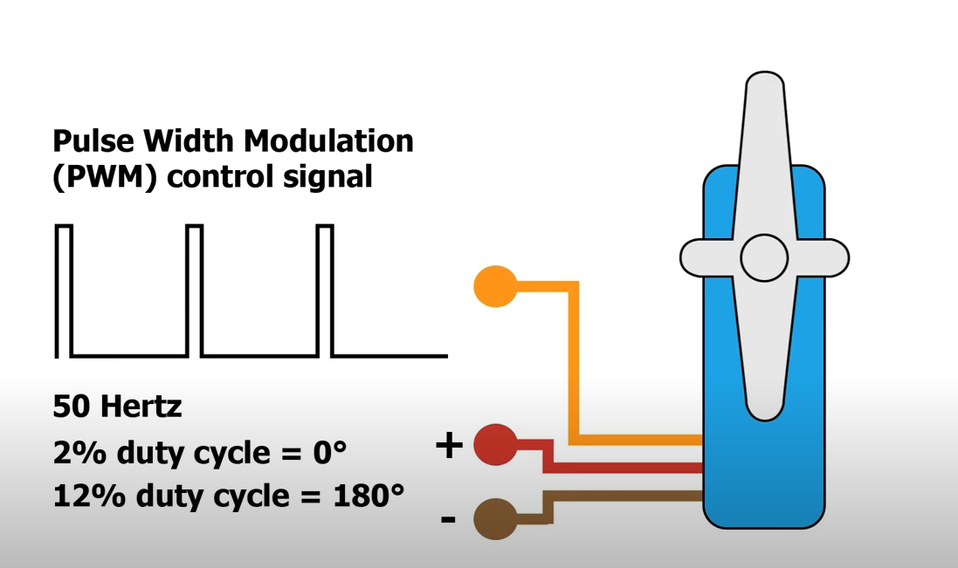

Slide 12
EXPLAININGCOMPUTERS.COM
https://www.youtube.com/watch?v=xHDT4CwjUQE&t=239s

Slide 13
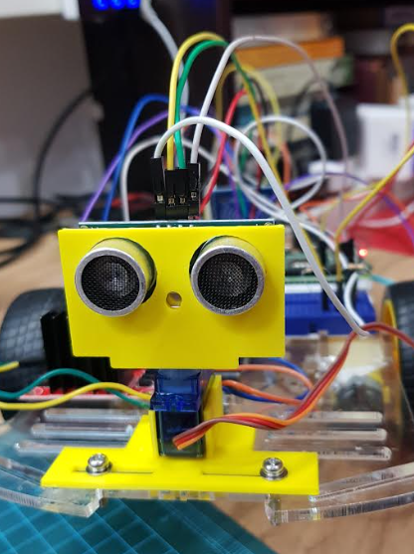
MOUNTING SERVO MOTOR AND ULTRASONIC SENSOR TO THE ROBOT

Slide 14
Factors determining performance of autonomous robot
Weight of Robot (Pi, Battery, Power Bank, Components)
Quality of Robot (friction on wheels affects direction)
Servo Motor Calibration
Type of battery driving H-Bridge
USB Rechargeable 9V 550mah recommended
- Assembly

